Slide 1
ATP
First Data Exploration
Patrick

Slide 2
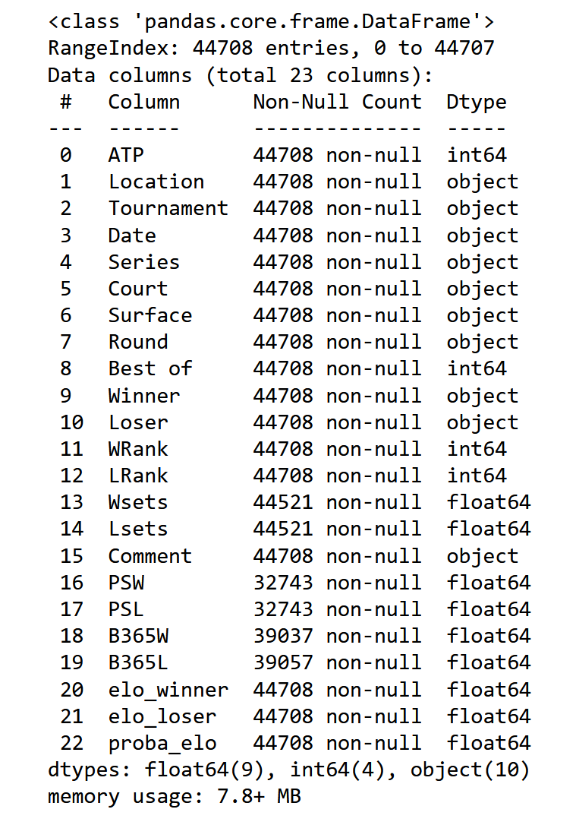
ATP Column = ATP identifier
[order of tournaments from first (1:69) to last ]

Slide 3
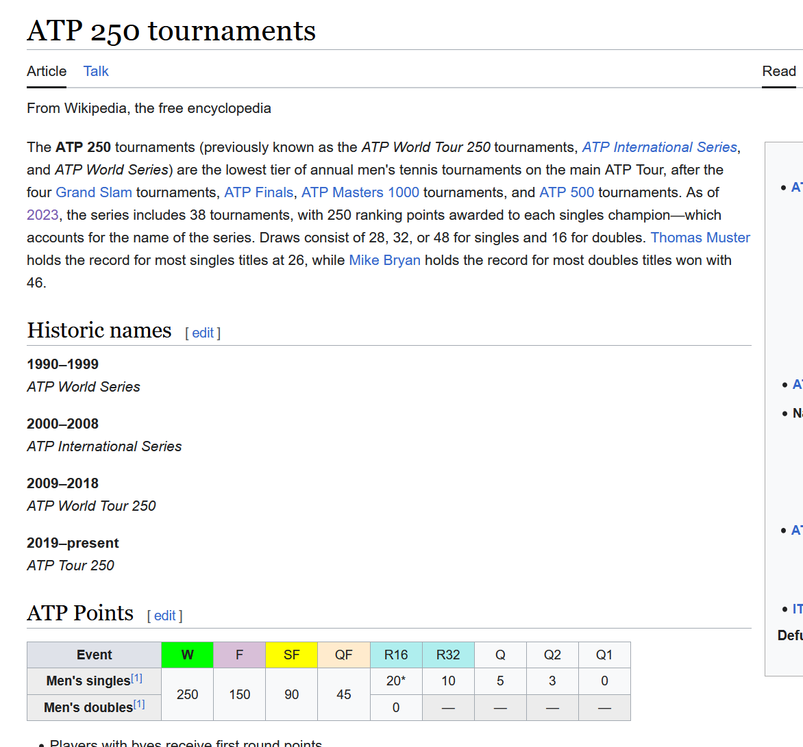

Slide 4
 | ATP | Best of | WRank | LRank | Wsets | Lsets | PSW | PSL | B365W | B365L | elo_winner | elo_loser | proba_elo
count | 44708.000000 | 44708.000000 | 44708.000000 | 44708.000000 | 44521.000000 | 44521.000000 | 32743.000000 | 32743.000000 | 39037.000000 | 39057.000000 | 44708.000000 | 44708.000000 | 44708.000000
mean | 32.803659 | 3.372596 | 59.159681 | 93.674108 | 2.140630 | 0.406325 | 1.927563 | 4.240179 | 1.822246 | 3.551007 | 1684.023280 | 1608.755552 | 0.585594
std | 18.170565 | 0.778702 | 74.881003 | 124.987643 | 0.462388 | 0.557349 | 1.359136 | 5.744329 | 1.107547 | 3.498689 | 179.246422 | 137.949299 | 0.198732
min | 1.000000 | 3.000000 | 0.000000 | 0.000000 | 0.000000 | 0.000000 | 1.000000 | 1.010000 | 1.000000 | 1.002000 | 1318.945207 | 1327.551888 | 0.008899
25% | 19.000000 | 3.000000 | 17.000000 | 35.000000 | 2.000000 | 0.000000 | 1.270000 | 1.794000 | 1.220000 | 1.720000 | 1548.476977 | 1501.546103 | 0.447921
50% | 32.000000 | 3.000000 | 41.000000 | 65.000000 | 2.000000 | 0.000000 | 1.549000 | 2.660000 | 1.500000 | 2.500000 | 1652.866073 | 1580.743828 | 0.589218
75% | 49.000000 | 3.000000 | 77.000000 | 105.000000 | 2.000000 | 1.000000 | 2.140000 | 4.270000 | 2.000000 | 4.000000 | 1780.755524 | 1684.607134 | 0.737288
max | 69.000000 | 5.000000 | 2000.000000 | 2000.000000 | 3.000000 | 2.000000 | 46.000000 | 121.000000 | 29.000000 | 101.000000 | 2392.408923 | 2392.595567 | 0.995601

Slide 5
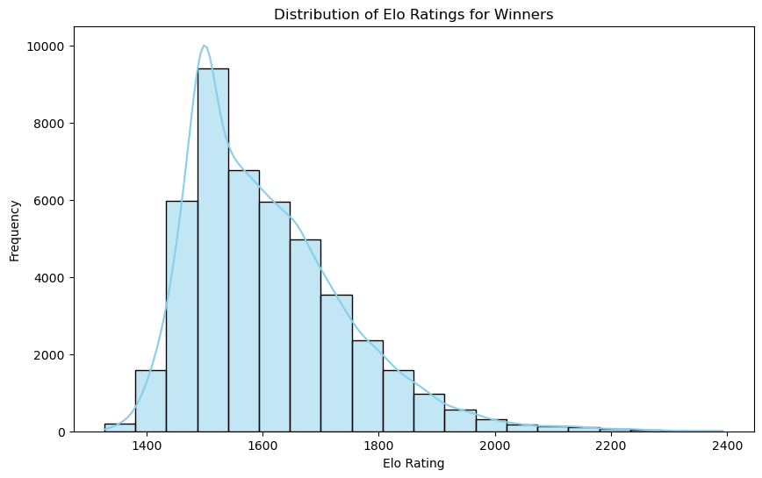
Distribution of Elo

Slide 6
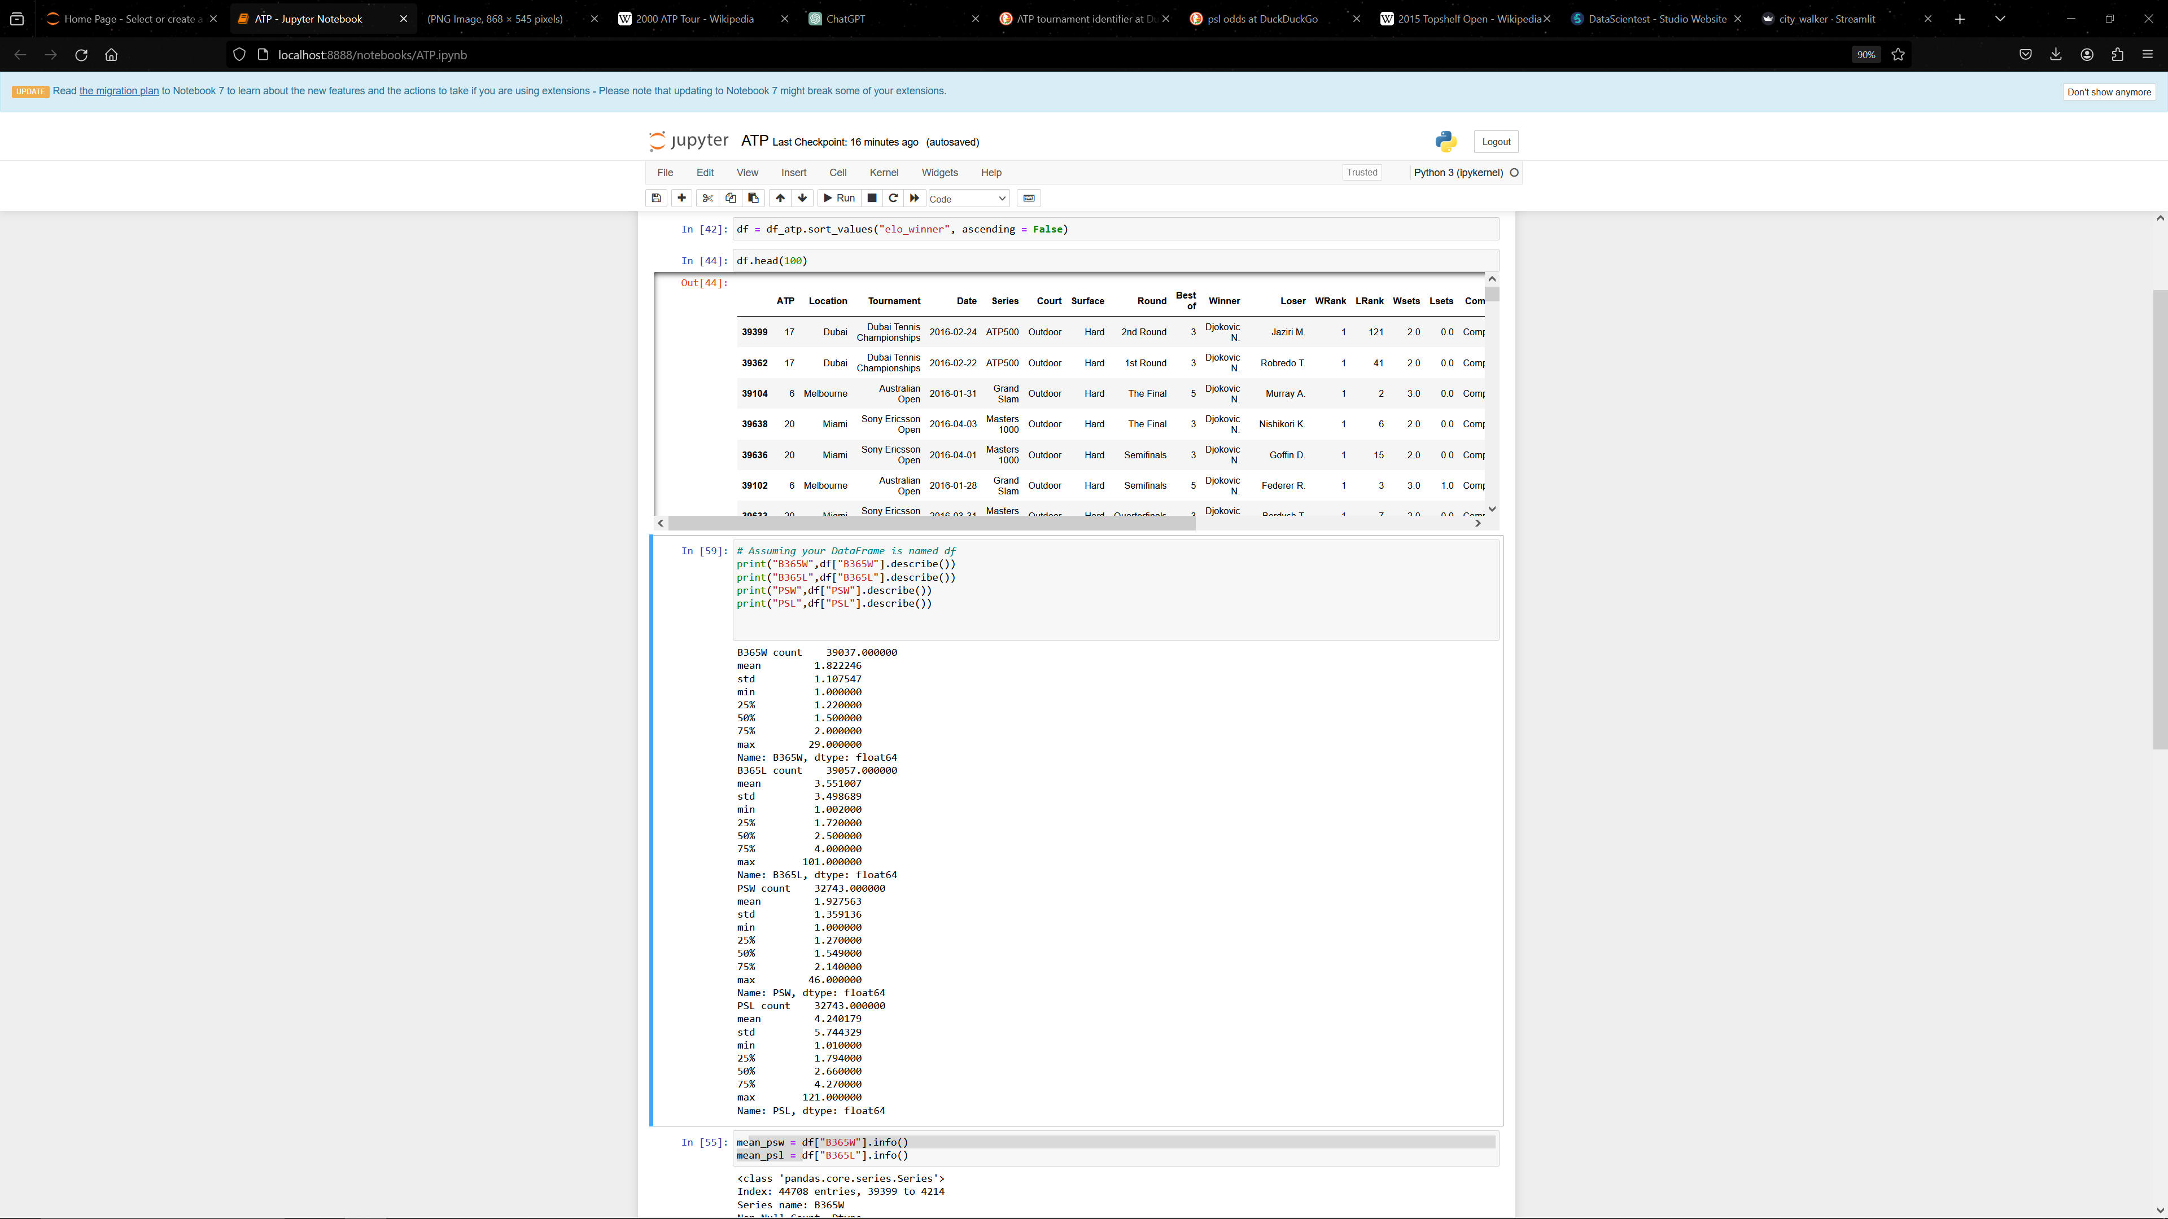

Slide 7
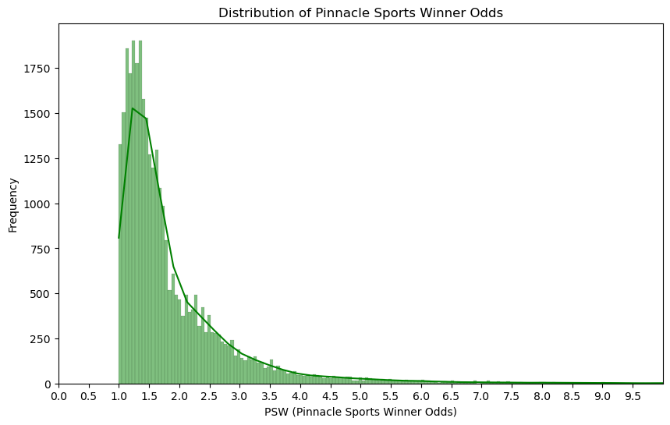

Slide 8
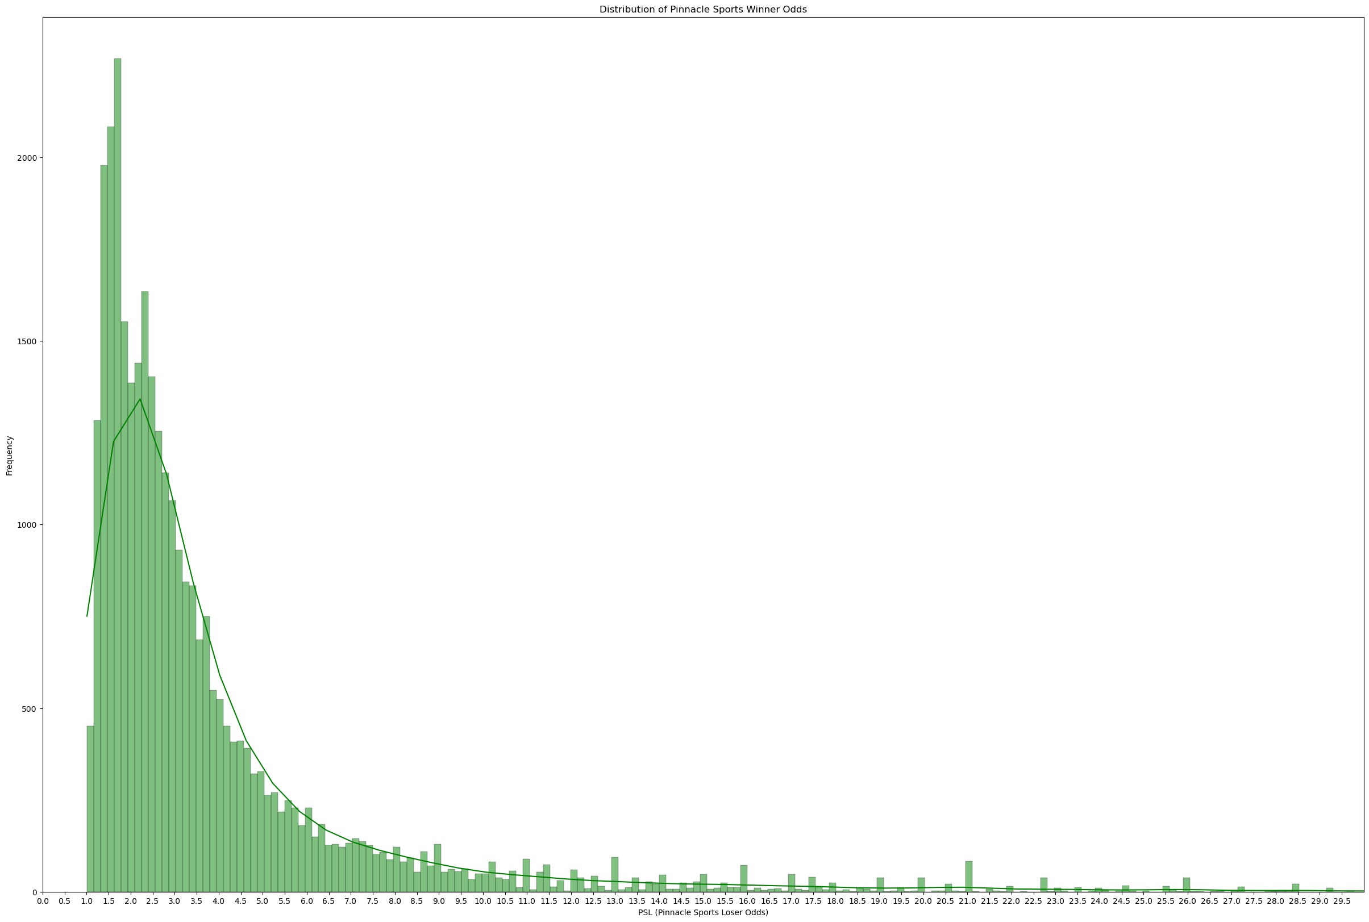

Slide 9
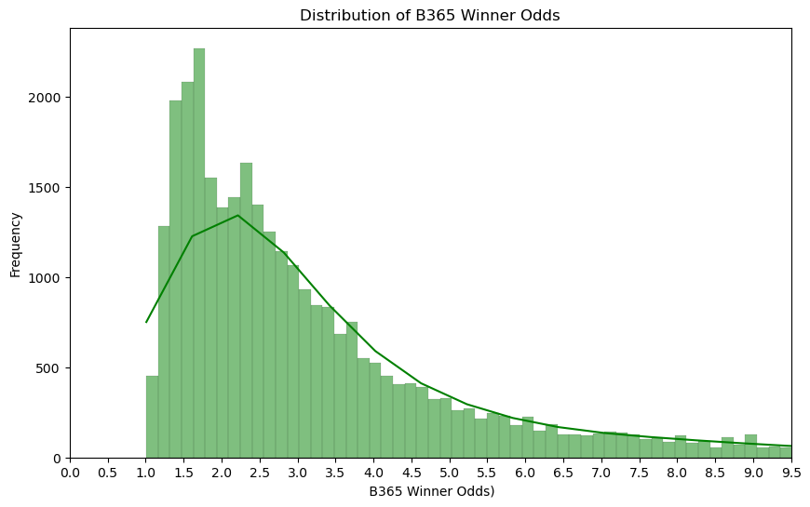

Slide 10
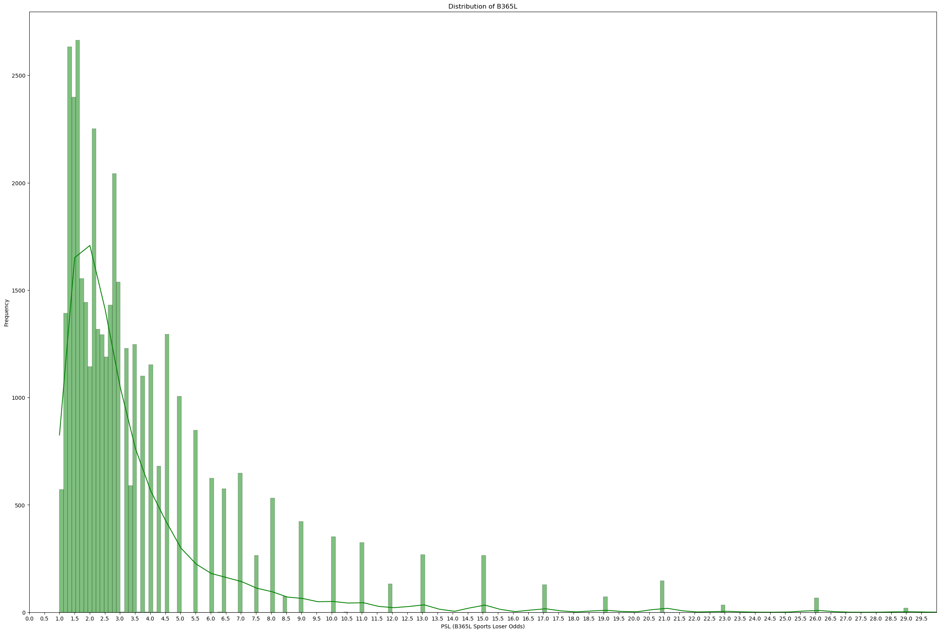

Slide 11
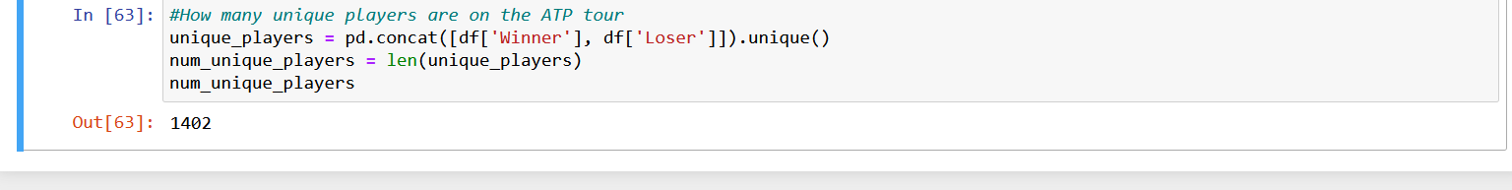

Slide 12
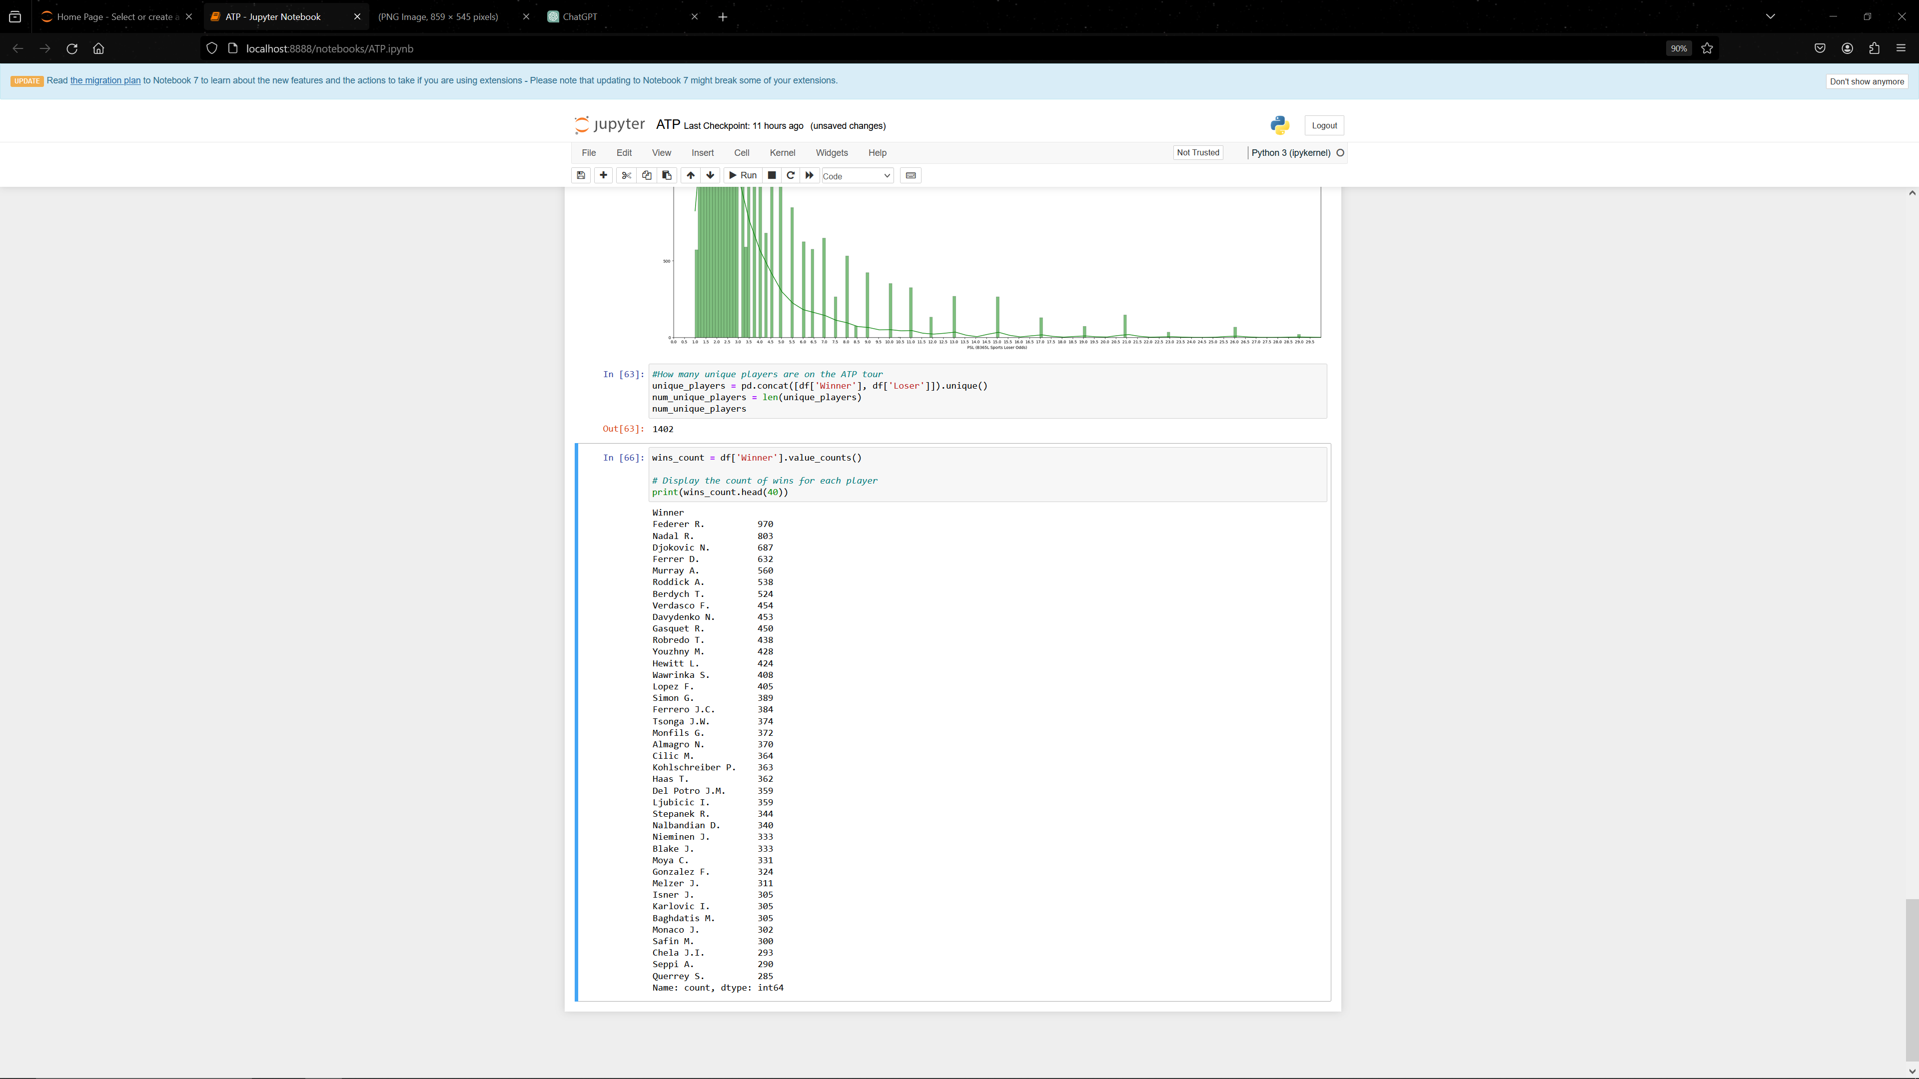
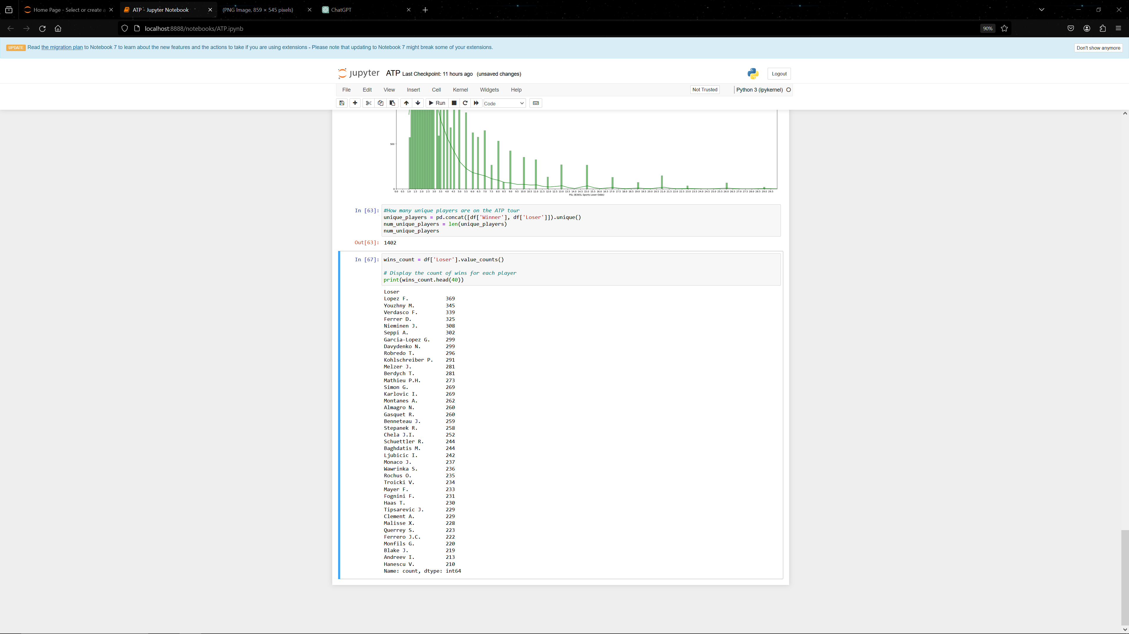

Slide 13
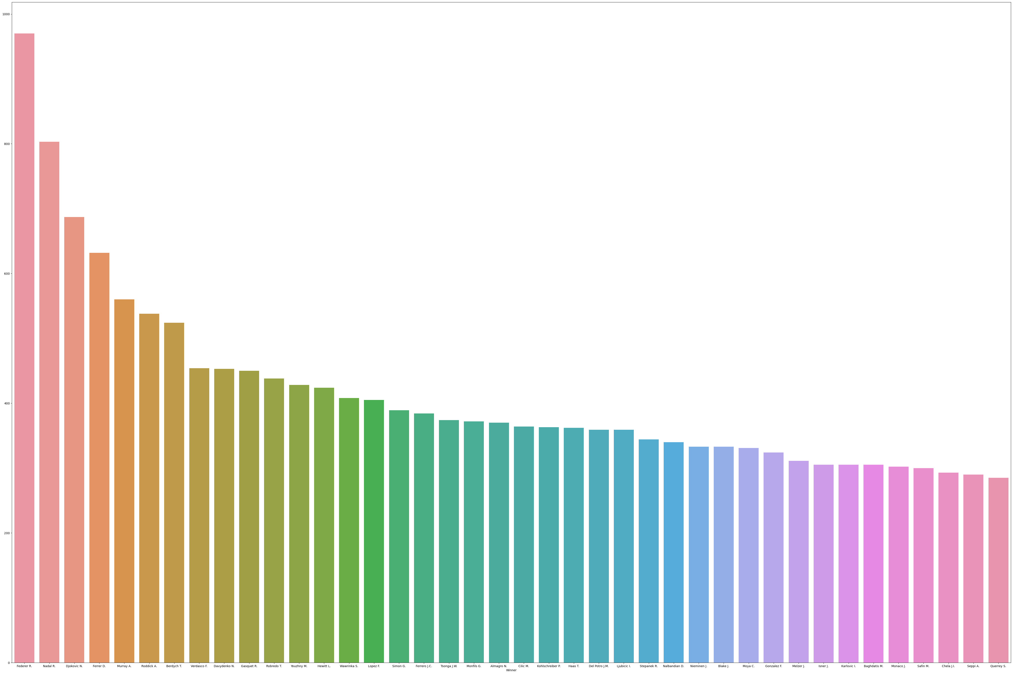
Winner

Slide 14
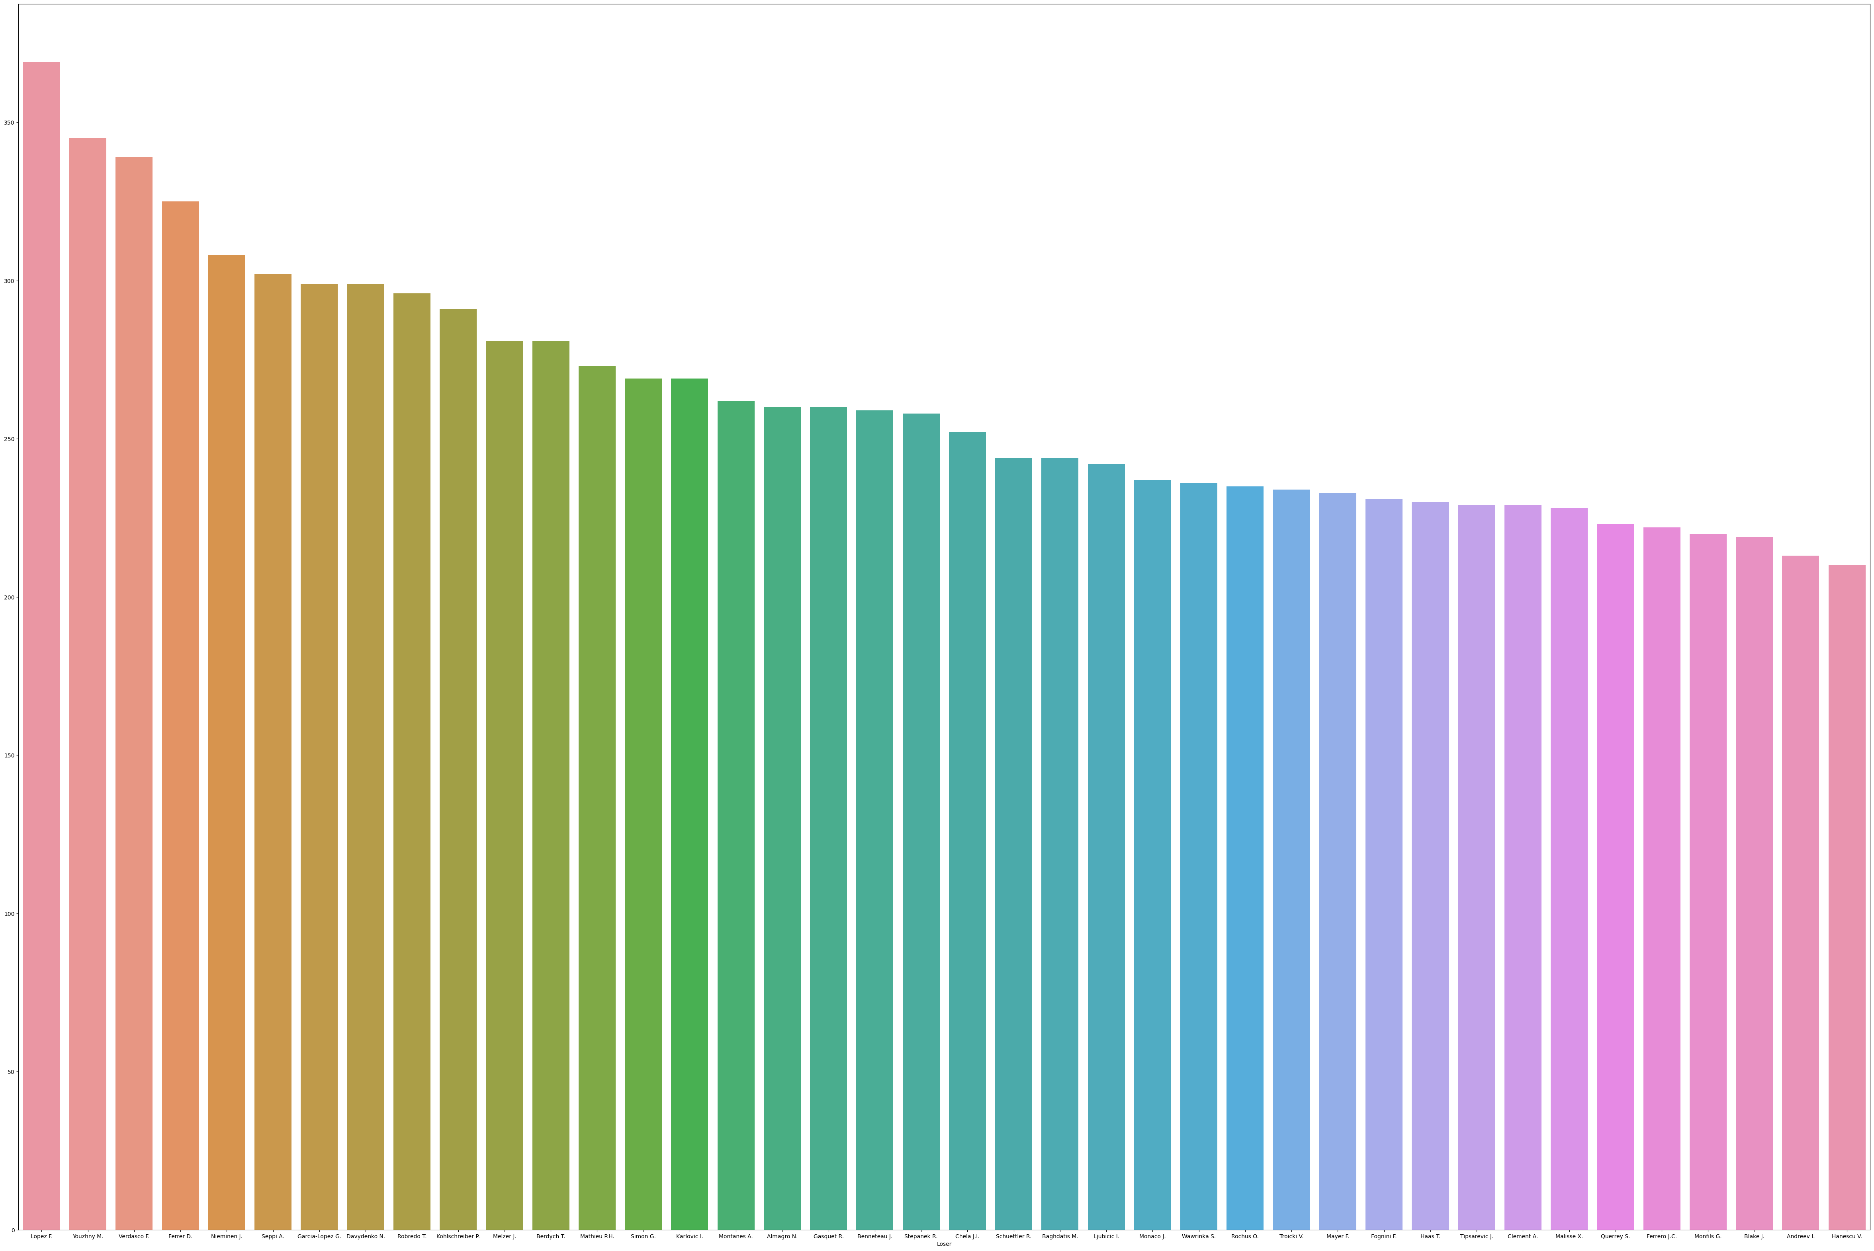
Loser

Slide 15
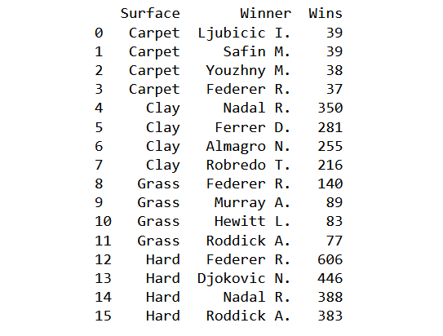

Slide 16
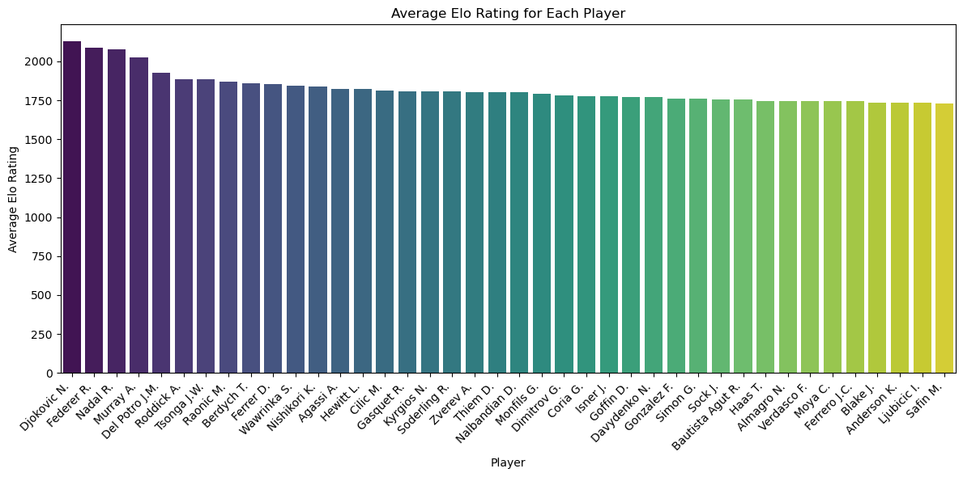

Slide 17
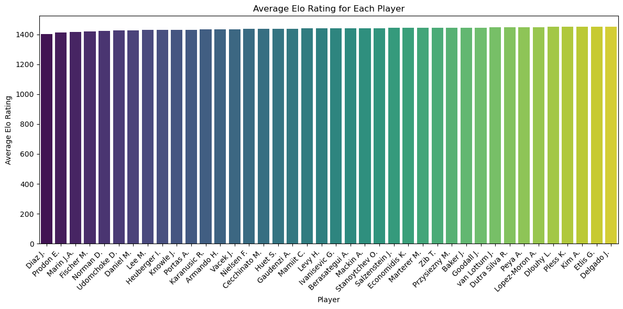

Slide 18
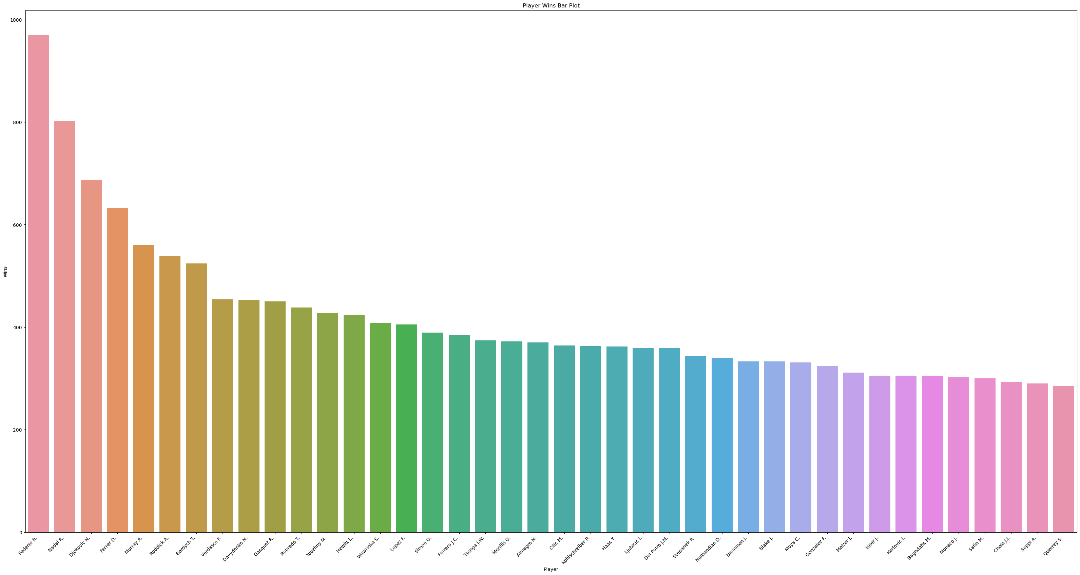

Slide 19
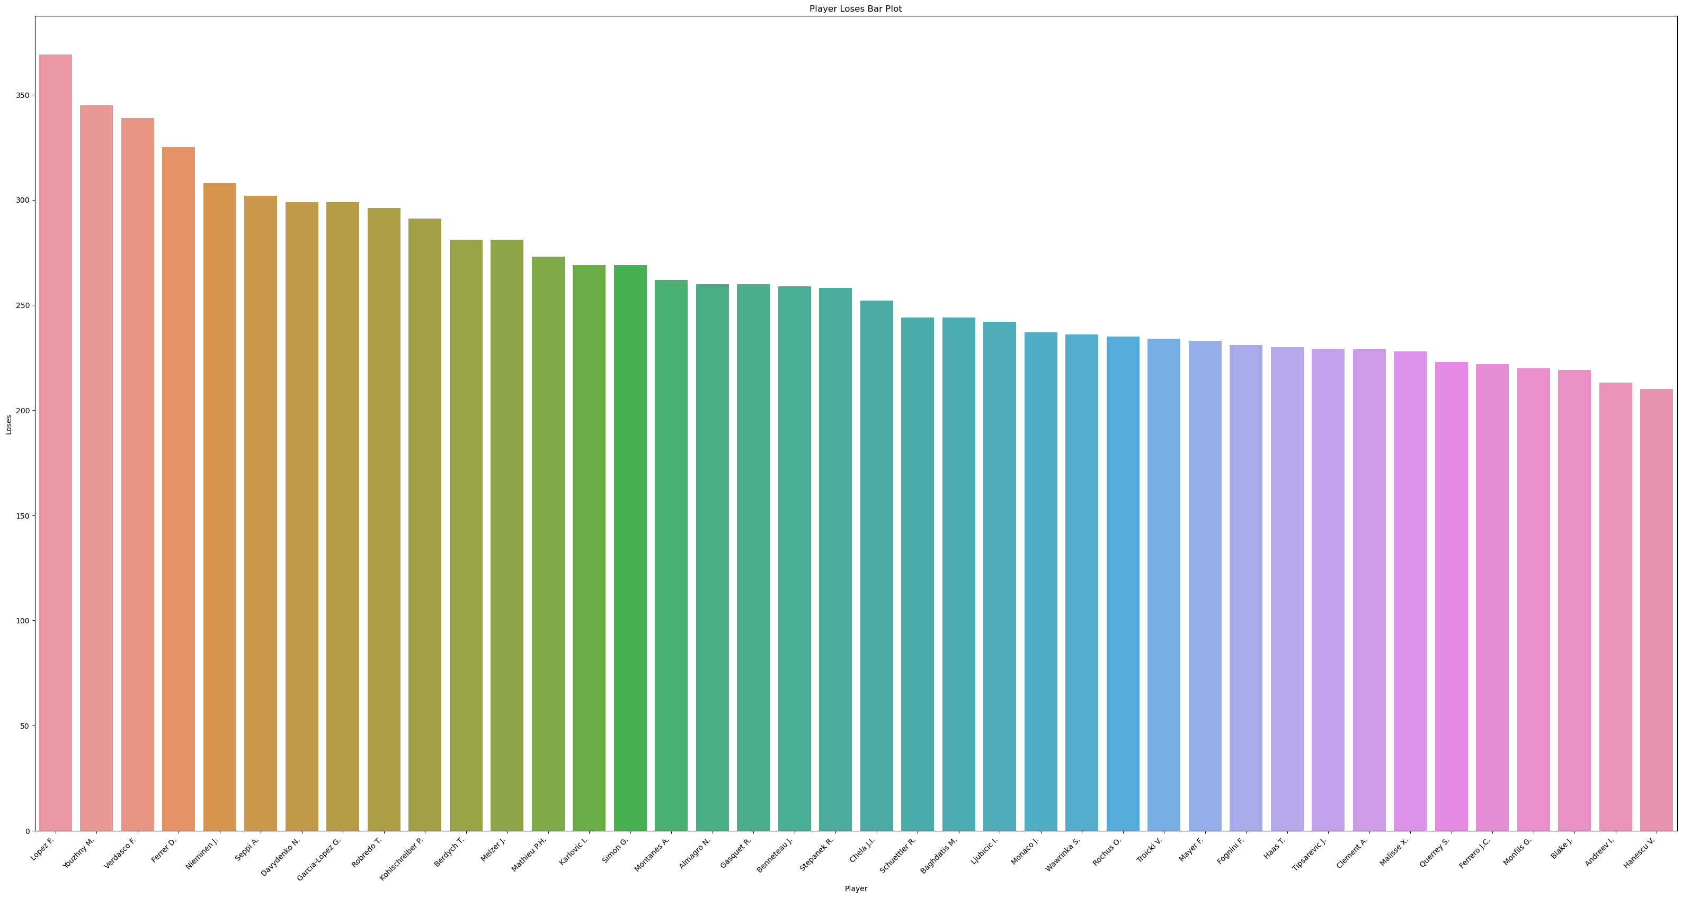

Slide 20
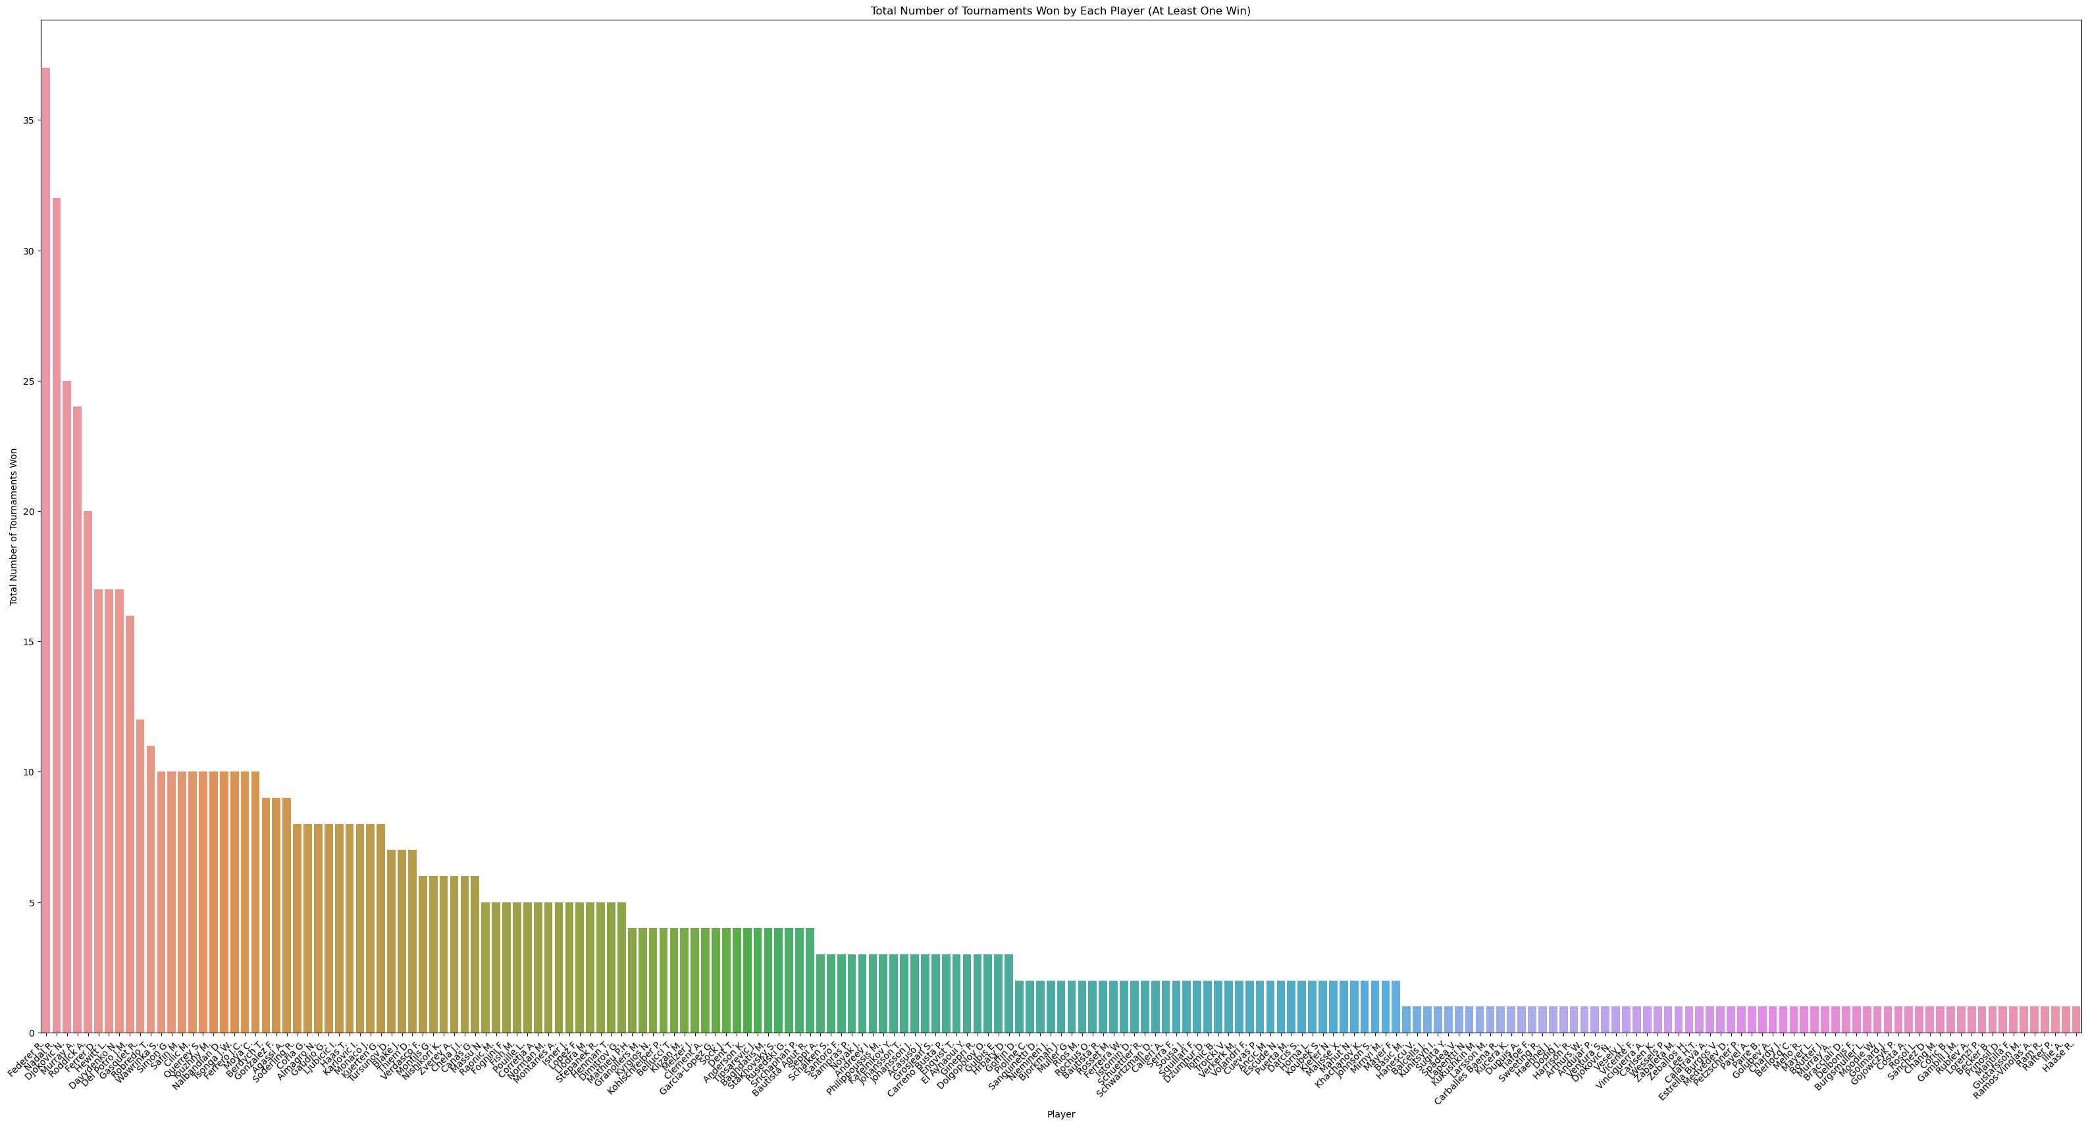
Ui´que wons

Slide 21
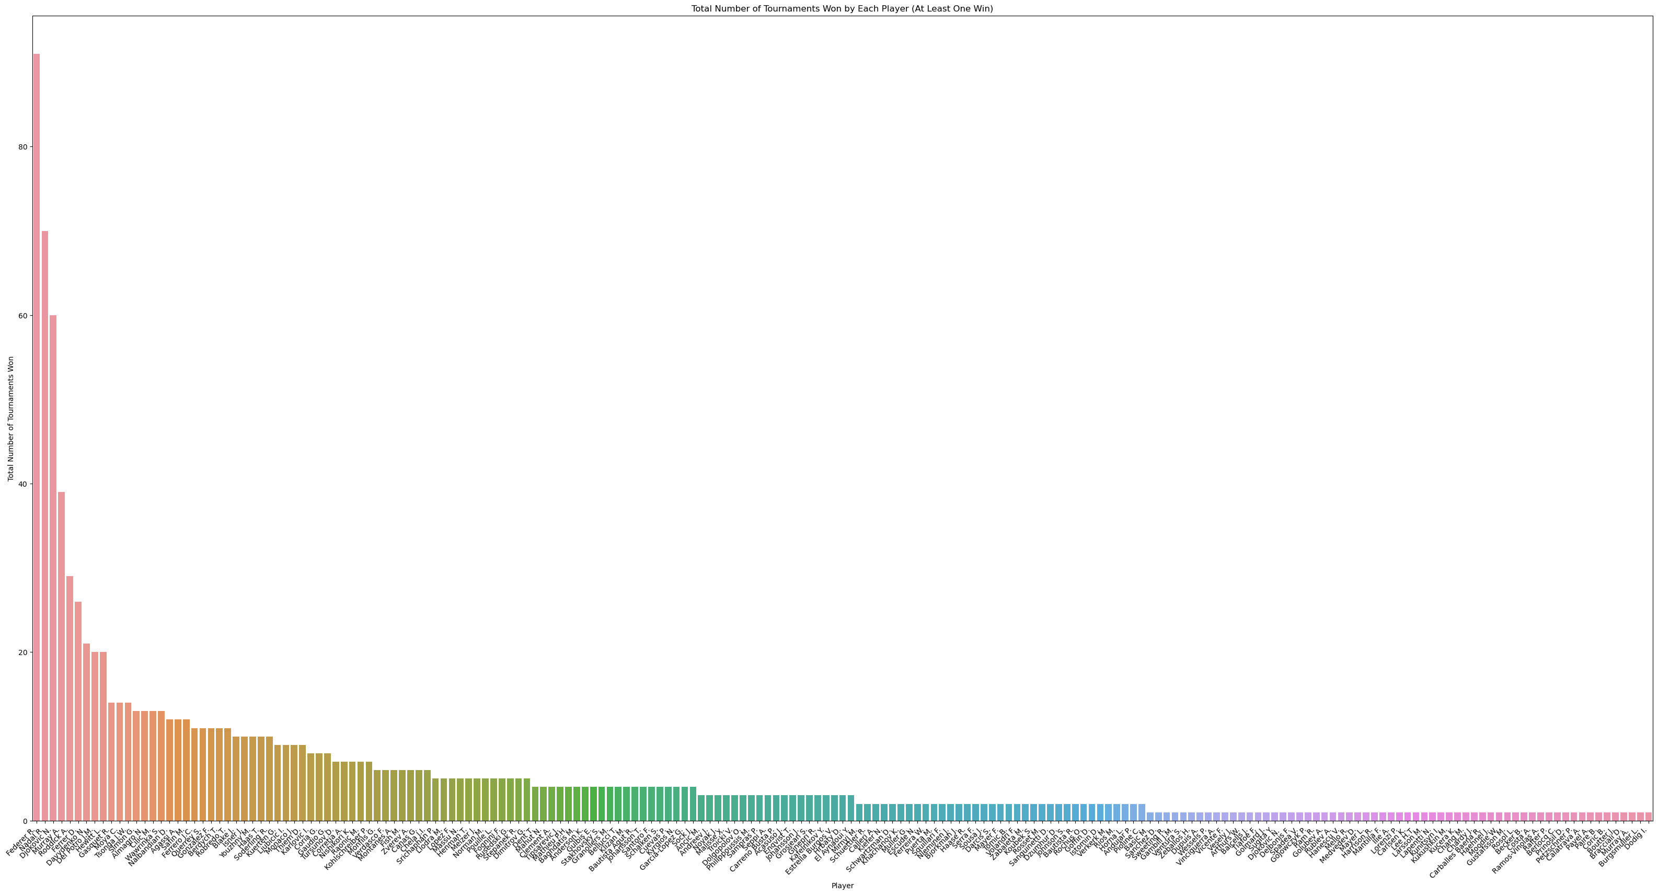
Total wons

Slide 22
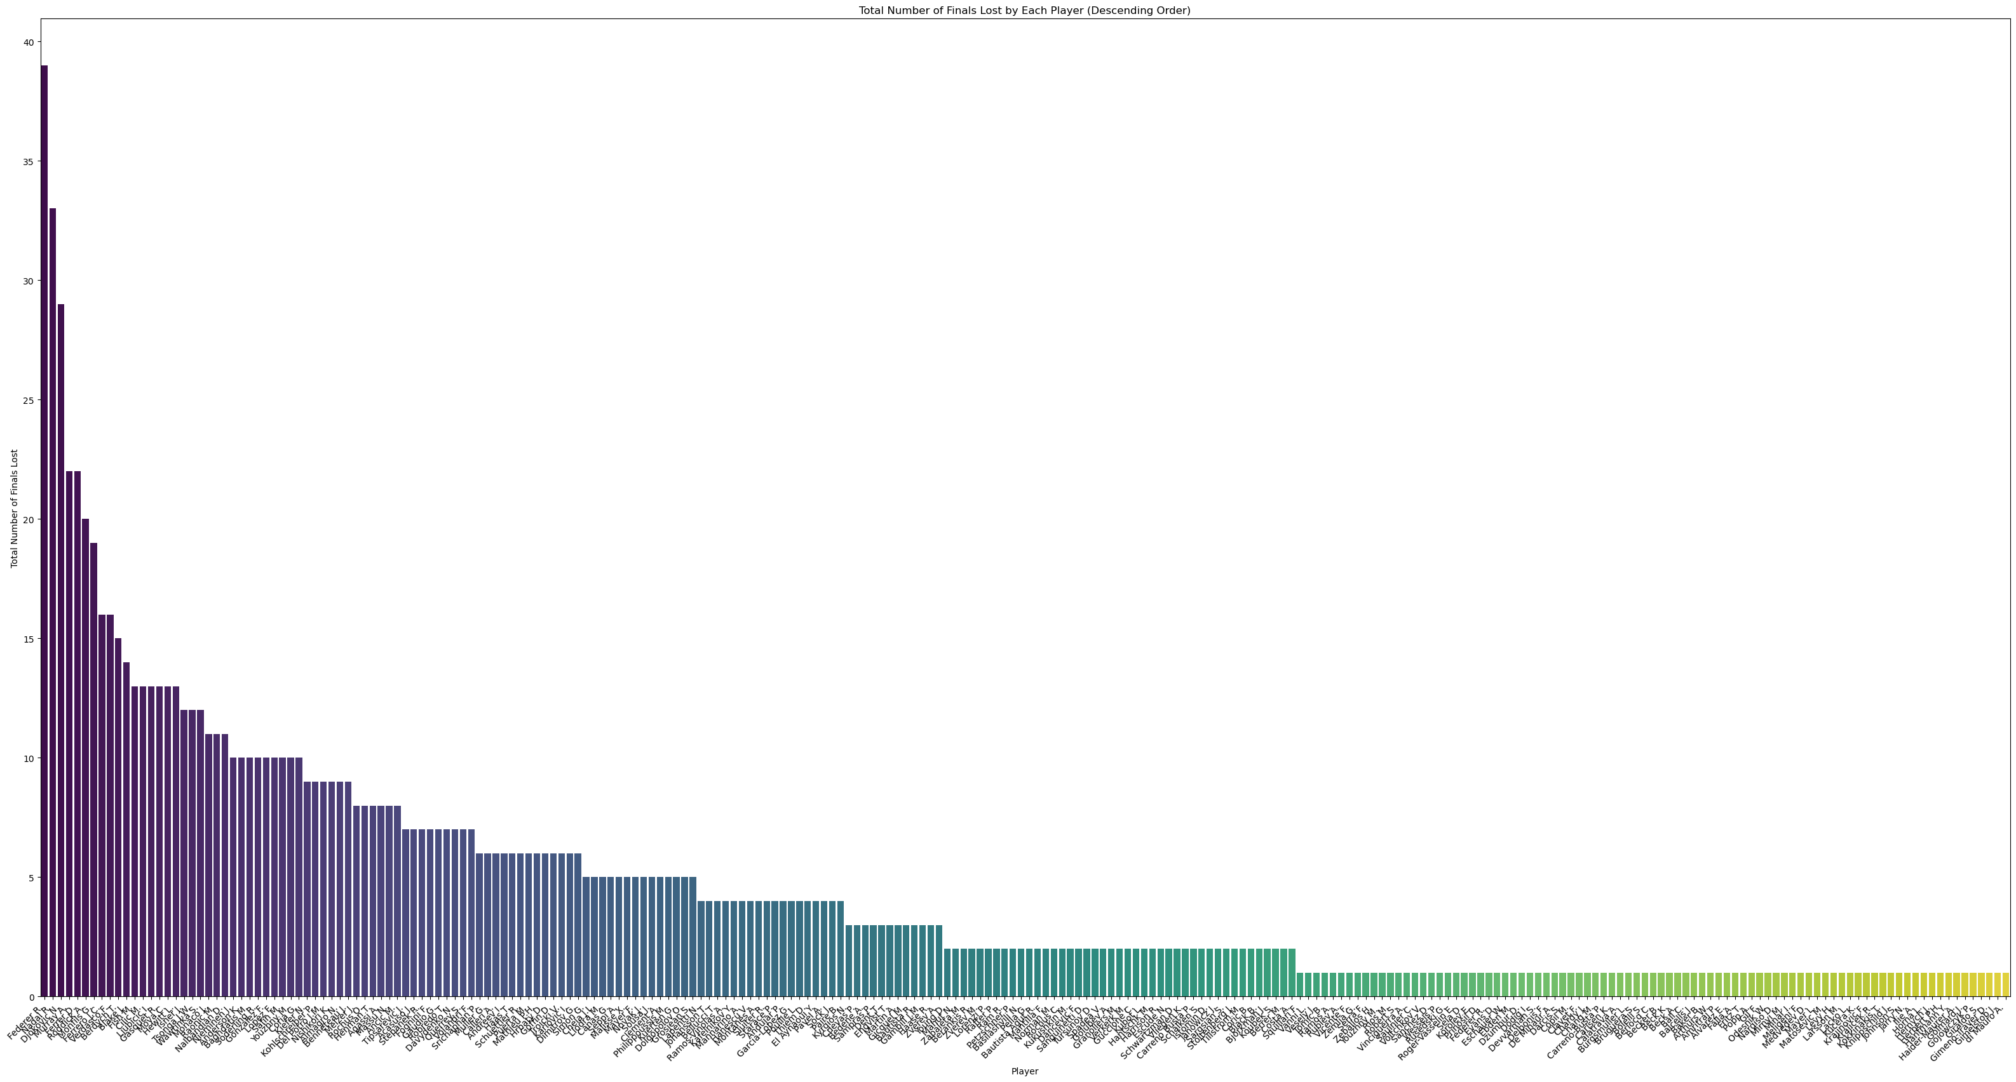
Total lost by each player

